Slide 1


Privacy
School of Business, Law and Entrepreneurship
Online Learning Materiel: Week 4 Presentation 2

Slide 2

This session’s roadmap
What we will be covering.
Privacy Legislation and where to get Privacy help
Privacy by Design (PbD) as a suitable framework/model
Privacy Impact Statements

Slide 3

Key privacy legislation.
What’s the key privacy legislation in the jurisdiction of where you were born, live, work, visit?
Privacy Act 1988 (Privacy Act)
Australian Privacy Principles (APPs)
Notifiable Data Breaches (NDB) scheme

Slide 4
The Privacy Act (1988).
The Privacy Act regulates the privacy components of the consumer credit reporting system, tax file numbers, and health and medical research.
For example, it covers:
How your personal information is collected (e.g., the personal info you provide when you fill in a form)
How it is then used and disclosed
Its accuracy
How securely it is kept
Your general right to access that information
The Privacy Act includes 13 Australian Privacy Principles (APPs) which apply to some private sector organisations, as well as most Australian and Norfolk Island Government agencies. See next Slides

Slide 5

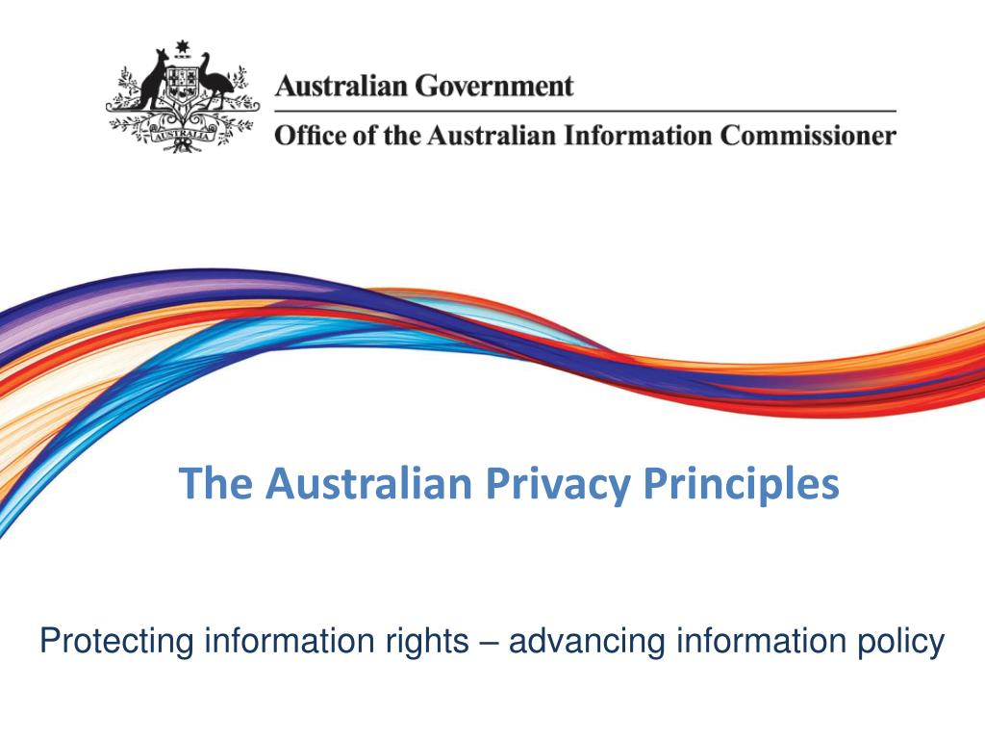


Shallow Dive: The Australian Privacy Principles (APPs).
Please watch the short (7 minute) recording on the APPs in this week’s theory folder.
Visit the 3 organisations listed on the last slide of the short recording.
Click on the image below to be taken to the homepage of the APPS.

Slide 6
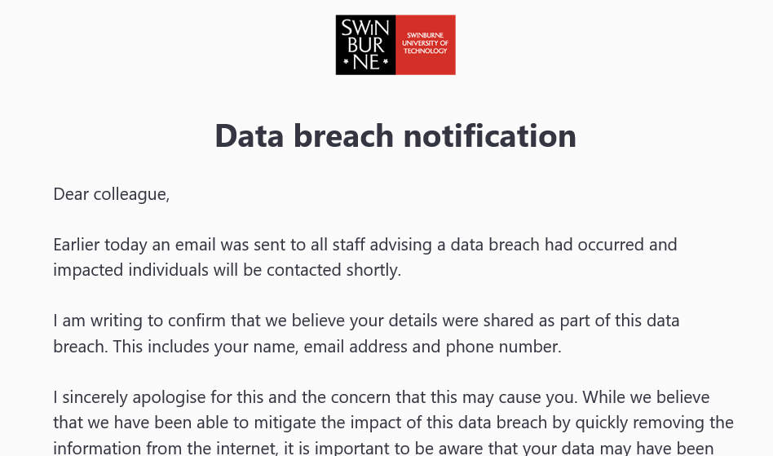


Notifiable Data Breaches (NDBs) / Privacy Amendment.
On 22 February 2018, a new Notifiable Data Breaches scheme came into force because of the Privacy Amendment (Notifiable Data Breaches) Act 2017.
The scheme applies to all entities with an annual turnover of $3 million plus and are currently subject to the Privacy Act 1988.

Slide 7
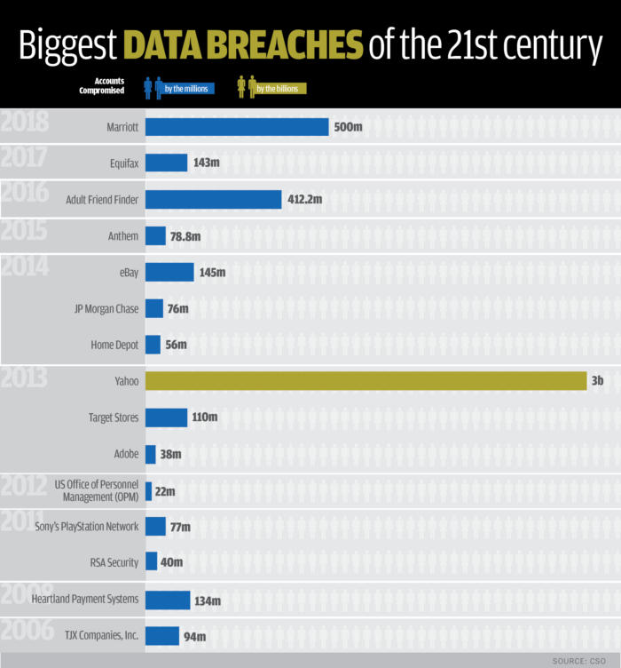



Slide 8
Privacy Qs from an ICT Professional / Organisational Perspective.
What does YOUR organisation regard as privacy?
What does YOUR organisation regard as information which no-one should have access to?
What information do you believe [Google or insert company name here] should have access to about YOUR organisation?
What company information do you believe YOUR government should have access to?
Would having more shared electronic information not mean that better services could be provided to YOUR customers?
Is the loss of YOUR organisation’s privacy worth the benefits?

Slide 9
Privacy Qs from an ICT Professional / Organisational Perspective /2.
As ICT professionals you should be aware of privacy principles and how they might affect your work:
APPs clearly have an impact on systems that store/access/use that data
Are you building a network that sends data offshore?
Are you building a database application that does not have appropriate access controls and allows ready identification of and individual’s?
Are you building an application that collects data about an individual without them knowing?
When developing system requirements are you able to brief the end users and client advocates on how these principles might affect them?

Slide 10
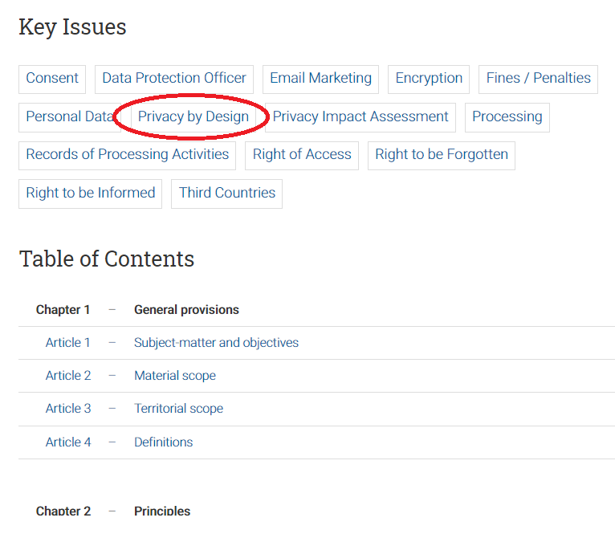
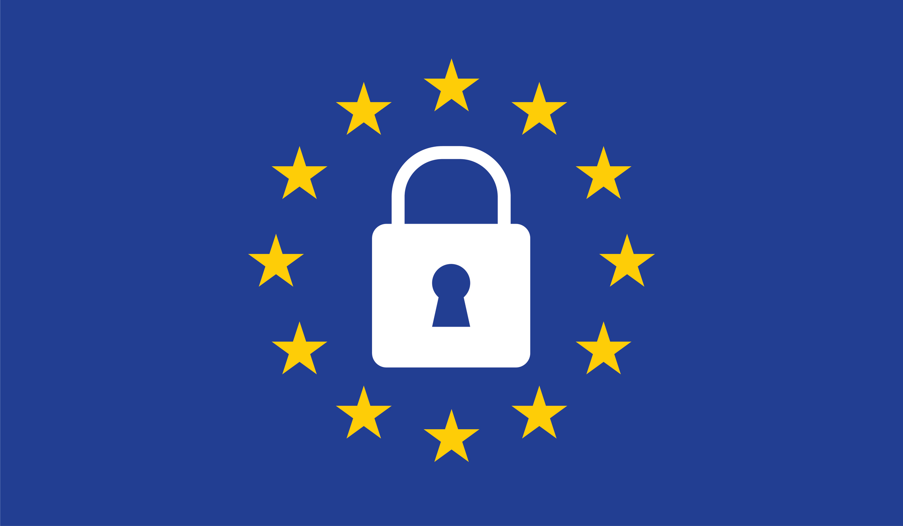
GDPR / General Data Protection Regulation.
Data protection and privacy in the European Union and the European Economic Area
Implemented on 25th May 2018
7 Principles: Lawfulness, fairness and transparency.
Purpose limitation.
Data minimisation.
Accuracy.
Storage limitation.
Integrity and confidentiality (security)
Accountability.
Controller: determines the purposes and means of the processing of personal data
Processor: processes personal data on behalf of the controller
“So what?” for Australians?

Slide 11
Privacy by Design (PbD).
PbD is a specific approach to privacy, developed by the former Privacy and Information Commissioner of Ontario, Canada, Dr Ann Cavoukian @AnnCavoukian
PbD is a methodology that enables privacy to be ‘built in’ / ‘baked in’ to the design and architecture of information systems, business processes and networked infrastructure.
PbD aims to ensure that privacy is considered before, at the start of, and throughout the development and implementation of initiatives that involve the collection and handling of personal information.
To address the ever-growing and systemic effects of Information and Communication Technologies, and of large-scale networked data systems
Adopted by the Victorian (Australia) Government & EU GDPR

Slide 12
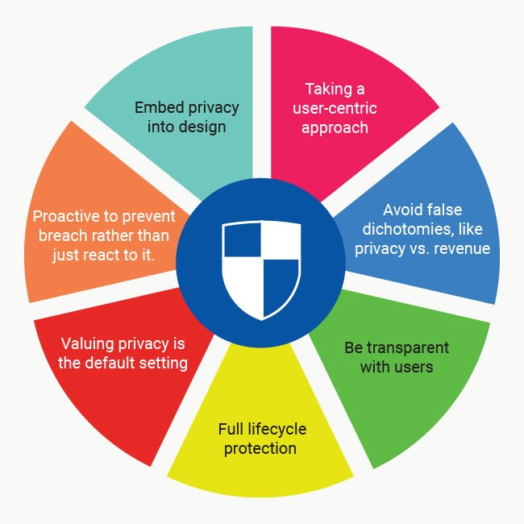
Privacy by Design (PbD) /2.

Slide 13
Privacy Impact Assessment (PIA).
A systematic assessment of a project that identifies the impact that the project might have on the privacy of individuals, and sets out recommendations for managing, minimising or eliminating that impact.
A PIA is useful to:
describe how personal information flows in a project;
analyse the possible impacts on individuals’ privacy;
identify and recommend options for avoiding, minimising or mitigating negative privacy impacts;
build privacy considerations into the design of a project; and
achieve the project’s goals while minimising the negative and enhancing the positive privacy impacts.

Slide 14

Privacy Impact Assessment (PIA) /2.
Threshold assessment
Plan the PIA
Describe the project
Identify and consult with stakeholders
Map information flows
Privacy impact analysis and compliance check
Privacy management — addressing risks
Recommendations
Report
Respond and review.
https://www.oaic.gov.au/privacy/guidance-and-advice/guide-to-undertaking-privacy-impact-assessments/

Slide 15

Privacy HELP.

Slide 16
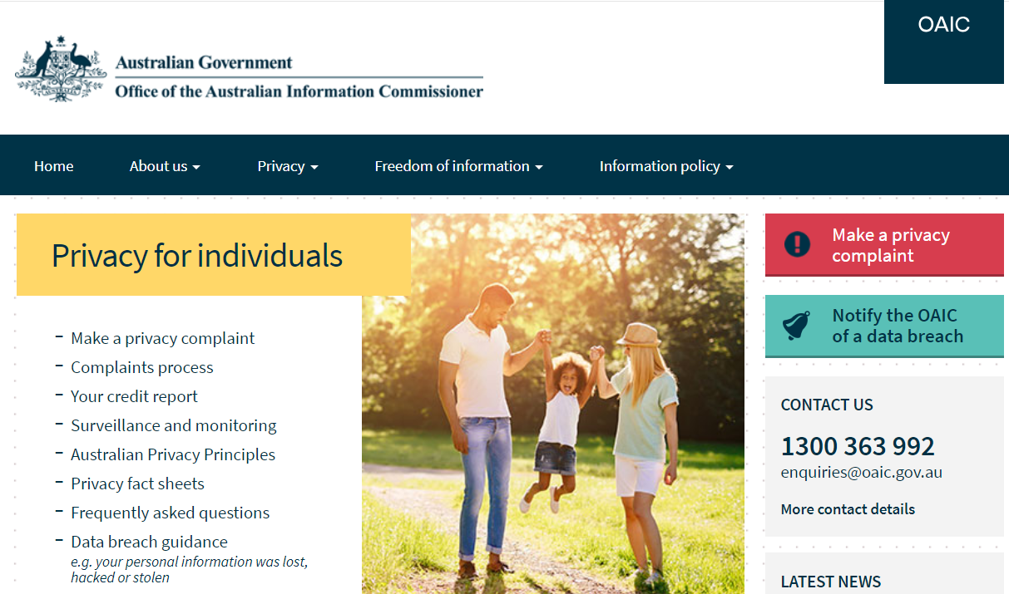

Where to get Privacy HELP.
Australian Federal Privacy Commissioner
The Commissioner performs key functions under the Privacy Act 1988, such as:
Providing information and advice about privacy and the law,
Handling complaints
Conducting audits, and
Undertaking promotional and educational activities.
https://www.oaic.gov.au/

Slide 17

Where to get Privacy HELP /2.
Australian Privacy Foundation
The Foundation aims to focus public attention on emerging issues which pose a threat to the freedom and privacy of Australians. The Foundation has led the fight to defend the right of individuals to control their personal information and to be free of excessive intrusions.
The Privacy Foundation is an entirely voluntary organisation
Where possible, it cooperates with & supports official agencies, but it is entirely independent -& often critical- of the performance of agencies set up to protect our privacy.
Currently: contributing to the development of industry codes, highlighting privacy risks in emerging technologies including biometrics & participating in global efforts to make the Internet safe for personal privacy.

Slide 18
Where to get Privacy HELP /3.
Corporate policies
Yours and the companies you deal with!
Industry bodies
International Association of Privacy Professionals - Australia/New Zealand
www.iappANZ.org
Advocacy Group
Privacy International
http://www.youtube.com/watch?v=SSYXw87BWXo
http://www.youtube.com/watch?v=QsG-UoZnPTo

Slide 19

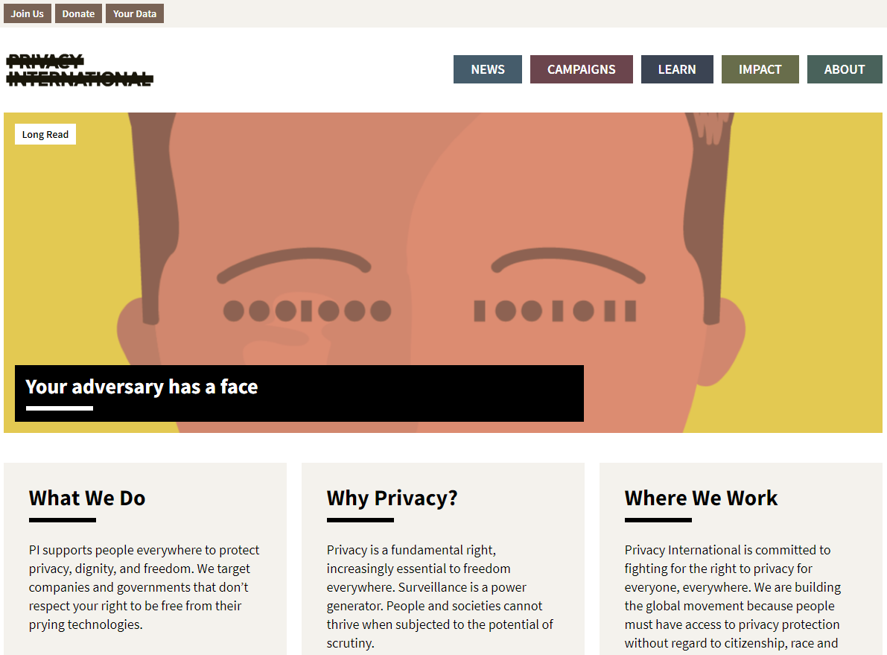
Where to get Privacy HELP /4
Privacy International.
https://privacyinternational.org/

Slide 20
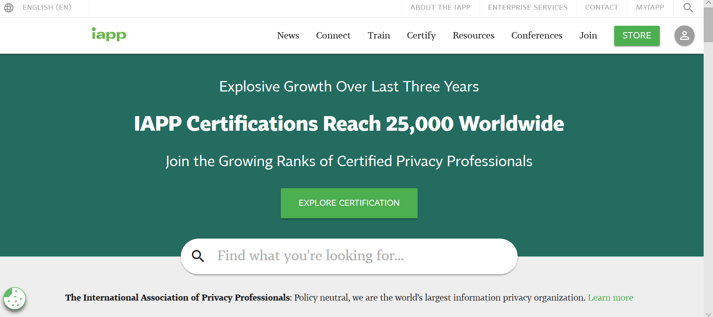
Where to get Privacy HELP /5.
International Association of Privacy Professionals.
https://iapp.org/

Slide 21

A useful summary from Emma Butler.*
“We're living in an era where almost everything we do now leaves some sort of data trail, due to advancements in technology and the fact that so much of our lives are spent online." Raising awareness of privacy matters at work and at home, encourages people to think not only about the information we share but also how that data is used. "At some point today, we should all take a moment to reflect on who has access to our information, why they need it and what it is being used for”.
* Data Protection Officer, Yoti Inc, UK

Slide 22

Privacy Takeaways.
Privacy means different things to different people
Our privacy is valuable, and people will fight to protect it while others will give it away without a second thought (by accident or lack of awareness of the implications)
Privacy not only impacts individuals but also business
Technology facilitates the protection AND threats to privacy
Inappropriate, unintentional or intentional actions by an individual in your organisation can impact the entire organisation’s privacy
10 National Privacy Principles developed for the Australian context became 13 Australian Privacy Principles in April 2014. The Notifiable Data Breaches (Feb 2018) established requirements for entities in responding to data breaches
Privacy By Design (PbD) is a popular framework to consider privacy from a holistic viewpoint
The Federal Privacy Commissioner can provide advice on privacy issues

Slide 23
Have we met our objectives?
Understood the characteristics of Privacy
Understood why Privacy is important to individuals & organisations
Explored the context of Privacy & Technology
Identified and became familiar with key pieces of Privacy legislation
THINK & REFLECT upon Privacy issues as a current/future ICT Professional
Identify areas for further exploration in your own time
Left the session more knowledgeable than when arriving

Slide 24


